Slide 1

Principal Preparation Project in NYS
Retrospective and Look Ahead
webinar for the
Commission on Independent Colleges and Universities
Ken Turner (Director, Principal Preparation Project)
February 8, 2018

Slide 2
Recap: Deliverables
AKNOWLEDGEMENTS
Today features findings of a 37-member team. Thanks go to them and their co-chairs:
Helen “Nell” Scharf-Panero (Dir., Center for Educational Leadership, Baruch College)
David Flatley (Carle Place School District Superintendent)
Particular appreciation goes to professional organizations.
Leaders of organizations nominated team members and arranged focus groups
Professional organizations (CADEA and MCEAP)
Commission on Independent College and Universities (Office of President)
State university leaders (Office of Assistant Provost for Educational Leadership)
City university leaders (Office of the University-Wide Provost)
Principal groups (CSA, NYSFSA, CAS, SAANYS, ESSAA)
Teacher groups (NYSUT, UFT)
Superintendent groups (NYSCOSS and the District Superintendents)
School Board group (NYSSBA)
Parent group (NYSFTA)
Community & Civil Rights groups (Nat’l Urban League, Rochester Mayor’s Office)

Slide 3
Recap: Deliverables
AKNOWLEDGEMENTS
This work is funded through the University of the State of New York Regents Research Fund by a pair of grants to the Fund from the Wallace Foundation.
Contributing as Advisory Team members were individuals with national expertise
Michelle Young
Executive Director, University Council for Educational Administration
Chair, Educational Leadership Constituent Council (ELLC)
Chair, National Educational Leadership Program standards team (NELP)
Erika Hunt
Senior Policy Analyst and Researcher
Center for the Study of Education Policy
Illinois State University
- Thanks go to Terry Orr for her help in keeping us mindful of what matters most
Assoc. Professor of Educational Leadership, Administration and Policy, Fordham
Exec. Committee, Metropolitan Council for Educational Program Administration

Slide 4



Recap: Deliverables
POINT OF DEPARTURE
Belief
Every student should have
great teachers and
a great school leader.
Mission
Enhance preparation and support for current and aspiring school building leaders, and thus contribute to improved student success.

Slide 5
Webinar OVERVIEW
This work has had two phases.
Phase 1: This work began in earnest in April 2016 and culminated in July, 2017. It produced a road map for improving principal preparation that includes 9 beliefs and 11 recommendations. With the assistance of MCEAP, guiding principles were identified to make “cultural responsiveness” more meaningful and actionable. And a web site now exists to house a growing library of material related to this topic (http://www.nysed.gov/schools/prinicpal-project-advisory-team).
Phase 2: The second began in August, 2017 and continues today. With five areas of focus, the expected completion date is December, 2018.
Today we’ll describe:
Why work began
What was accomplished and how
The path forward

Slide 6
to improvE principal preparation, where do you start?
If you could have what you want, what would you have?
Note: This framed the opening conversation of a 37-member Advisory Team that was appointed by the Commissioner. Responses from Advisory Team members were transformed into a set of belief statements that became the foundation for the recommendations that followed.

Slide 7
NEXT STEPS
9 Beliefs that anchor the work (1/3)
Purpose: Well-prepared school candidates make it their mission to support staff in the school so every student is equipped for success in the next level of schooling, career, and life; further, candidates have the ability to translate goals into plans, action, and desired results.
Equity: Well-prepared candidates cultivate a climate of compassion and care for the well-being of every child in the school; candidates create a culture that strives to support the learning needs of every student in an environment where all students are valued, are respected, and experience success regardless of their differences (age, gender, socio-economic status, religion, race, ethnicity, sexual orientation, disability, native language, or national origin).

Slide 8
NEXT STEPS
Belief statements (2/3)
Value Diversity: Effective preparation programs recruit and produce aspiring leaders from varied backgrounds and historically-under-represented populations who are committed to the success of every student, who value different learning styles, who promote instructional practices that capitalize on a range of cultural traditions, and who strive to eliminate prejudice, stereotype, bias, and favoritism.
Instruction: Well-prepared school building leader candidates have the knowledge and skill to improve teacher instruction and student learning.
Shared Decision-Making and Shared-Leadership: Well-prepared school building leader candidates have the willingness and ability to share decision-making and distribute leadership.

Slide 9
NEXT STEPS
Belief statements (3/3)
Continuous Improvement and Change Management: Well-prepared candidates display the emotional intelligence, skill, and grace needed to manage the tension and conflict that can arise when schools engage in continuous improvement efforts.
Collaborative Partnership: Well-prepared candidates have the skill, ability, and desire to collaborate so students, staff, and parents feel they belong and community members are valued and appreciated as respected partners.
Skillful Practice under Authentic Conditions: Effective preparation programs produce aspiring principals who demonstrate their readiness for school leadership by successfully applying the skills and knowledge they acquire within authentic settings throughout their preparation program.
Reflective Practice: Effective preparation programs require candidates to reflect upon their actions. Well-prepared building leader candidates rely on collegial feedback, student evidence, and current research to inform their reflection and guide their practice.

Slide 10
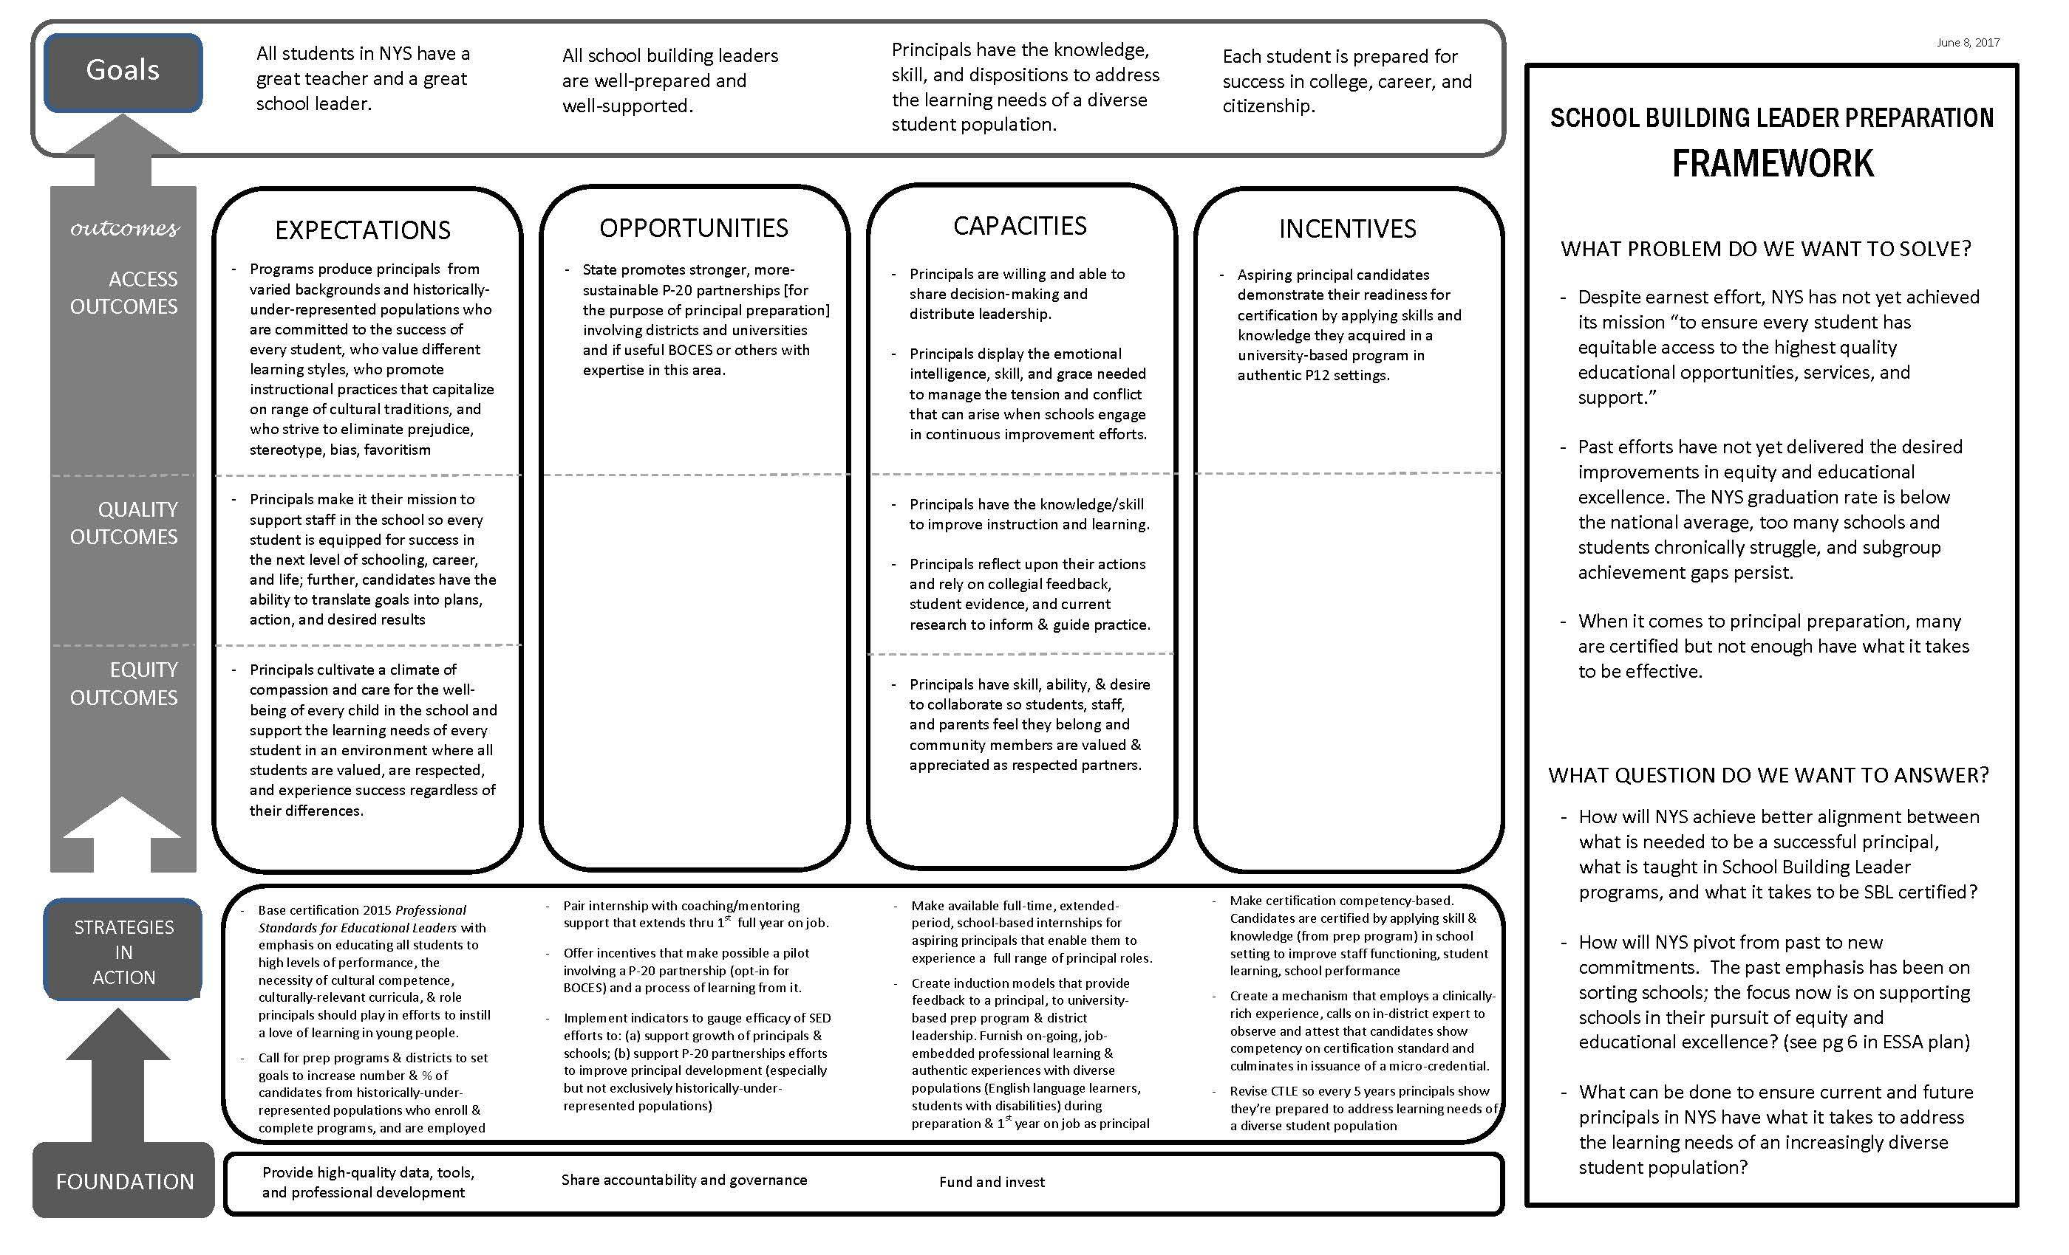
Recap: Deliverables
SBL PREPARATION FRAMEWORK (ROAD MAP)

Slide 11

CULTURAL RESPONSIVENESS
CULTURAL RESPONSIVENESS
In broad terms, cultural responsiveness means creating
instructional environments that propel learning by
connecting new learning to each student’s background and experience.
It is a commitment to practices that help all students use
landmarks of their own cultural background to build
knowledge, skills, and attitudes. From an instructional standpoint, it means making content accessible by teaching in a way that students understand. It means using students’ personal interest as a basis for connecting content to student’s personal experience.
To do this, educational leaders must be able to relate aspects of students' daily lives to the curriculum. If educational leaders value students’ cultural and linguistic background then educational leaders (and the members of their school staff) see these as capital to build on, not barriers to student learning. The aim is to improve the learning experience by enhancing engagement. Cultural responsiveness advances and accelerates learning by honoring and supporting students’ cultural, linguistic, and racial experiences.
* Sources: Ladson-Billings (2009 and 1994, p. 382), K. Rajagopal, Create Success! (July 27, 2017), Aceves,
Orosco (July 2014), CEEDAR Center and Gay (2010), Nieto, Bode, Kang, and Raible (2008)

Slide 12
CULTURAL RESPONSIVENESS
CULTURAL RESPONSIVENESS
A fuller description (with guiding principles) was developed by MCEAP, presented to the NYS Board of Regents on December 12, 2017 and is found on pages 36-42 at the following link.
https://www.regents.nysed.gov/common/regents/files/1217hea1.pdf
MCEAP proposed a thoughtful modification the concept of cultural responsiveness. As MCEAP describes, it “goes beyond cultural responsiveness to promote leadership that enacts cultural proficiency.”
Calling for a proposed revision of Standard 3 (“Equity and Cultural Proficiency”), MCEAP proposed the following phrasing.
“Effective educational leaders strive for equity of educational opportunity and culturally proficient practices to promote each student’s academic success and well being.”

Slide 13

Purpose: Where this journey began
In Fall, 2015, NYSED applied for foundation
funding to enhance state support for development
of school building leadership (SBL).
The initial proposal outlined four areas of focus:
Requirements pertaining to those who are seeking SBL certification *
Requirements for programs that prepare school building leaders
Professional development, supervision, and evaluation for school leaders
A tool to help districts identify, develop, select, and place school leaders
* The term “SBL” refers to school building leader. While we refer to this as the Principal Preparation Project, those holding SBL certification can also includes assistant principals, central office administrators, and those who choose to lead a school building as teacher

Slide 14

Why select this focus?
Districts typically expend 80% (or more) of operating funds on people.
So one of the most important decisions districts face is how to recruit, select, place, develop, and retain effective school building leaders.
Although progress has been made to improve national school leadership standards, until last month NYS had not taken steps in recent years to revise requirements for programs that prepare school building leaders.
Notably, in 2015 the National Policy Board for Educational Administration developed and copyrighted the Professional Standards for Educational Leaders or PSELs *
In addition, the Every Student Succeeds Act now includes provisions for states to use a portion of Title IIA funds for leadership development.
* http://www.ccsso.org/Documents/2015/ProfessionalStandardsforEducationalLeaders2015forNPBEAFINALpdf

Slide 15
NEXT STEPS
background on those producing standards
Since 1996, the National Policy Board for Educational Administration (NPBEA) has sponsored publication of national standards for educational leaders. For two decades, states have used these to guide certification for educational leaders.
In 1996, the Standards for School Leaders were published. Developed in association with the Interstate School Leaders Licensure Consortium (ISLLC), they were commonly called ISLLC Standards.
In 2008, the Education Leadership Policy Standards were published. Again prepared with the assistance of the Interstate School Leaders Licensure Consortium, these guided initial certification for school building leaders in New York State. They are commonly called the 2008 ISLLC Standards.
In 2015, the Professional Standards for Educational Leaders (PSELs) were published. NPBEA sponsored and led the production. The 2015 PSELs are today copyrighted by National Policy Board for Educational Administration.
In NYS, Principal Project Advisory Team has worked against this backdrop.

Slide 16
A closer look at most-current national standards for educational leaders
NEXT STEPS
National Policy Board for Educational Administration produced the 2015 Professional Standards for Educational Leaders. They include 10 standards.
The Mission, Vision, and Core Values
Ethics and Professional Norms
Equity and Cultural Responsiveness
Curriculum, Instruction, and Assessment
Community of Care and Support for Students
Professional Capacity of School Personnel
Professional Community for Teachers and Staff
Meaningful Engagement of Families and Community
Operations and Management
School Improvement
Note:
The three underlined items highlight areas where the PSELs represent the greatest change from the 2008 ISLLC Standards (that were created by the Interstate School Leaders Licensure Consortium).

Slide 17
NEXT STEPS
how do 2015 Professional standards for educational leaders (PSELs) compare to the 2008 isllc standards?
PSELs improve on 2008 ISLLC standards in five ways:
The PSELs have a stronger, clearer emphasis on academic success AND broader learning, student development, and student well-being.
The PSELs take a more systemic view of leadership work.
The PSELs place more importance on “each” student and “all” students.
The PSELs more explicitly use logic to link leadership to learning.
The PSELs call out certain areas for particular emphasis:
Equity and Cultural Responsiveness
Community of Care and Support for Students
Meaningful Engagement of Families and Communities
Reference: http://www.npbea.org/wp/wp-content/uploads/2014/11/PSEL-WebinarPowerPointSlides.pdf

Slide 18

What evidence IS THERE OF A need?
“States and districts struggle with a shortage of new
principals who possess competencies needed for effective
leadership. While training, candidates often do not receive
academic coursework and clinical experiences that
adequately prepare them for leadership positions in real life.
After graduation, new principals often do not receive
sufficient support and mentoring tailored to individual needs
to guide them in the first few years in leadership positions.” *
“Principal quality is second only to classroom instruction among factors that contribute to what students learn.” **
* Daugherty, Herman, and Unlu, “Logic Models for Selecting, Designing, and Implementing Evidence-Based School Leadership Interventions, RAND, 2017, p 9
** Leithwood, Seashore Louis, Anderson, and Walhstrom, How Leadership Influences Student Learning, NYC: Wallace, 2004

Slide 19
Recap: Deliverables
CLOSE LOOK AT PHASE ONE ACCOMPLISHMENTS
Work commenced in April, 2016. Since then . . .
After the Advisory Team delivered 9 beliefs and 11 recommendations to the Commissioner (July, 2017), the NYS Board of Regents acted (on Dec. 12, 2017) to alter SBL certification requirements.
The first of the 11 recommendations called for adopting PSELs.
With Regent action in Dec., 2017, the focus for principal preparation and practice shifted from the 2008 ISLLC Standards to the PSELs.
Beginning in Dec. 2020, university-based SBL prep programs will re-register with SED (demonstrating their programs shifted to PSELs).
Beginning Dec. 2022, all principal evaluations will be based on PSELs

Slide 20

NEXT STEPS
Advisory Team RECOMMENDATIONS (1/3)
Adopt most current national standards adding emphasis
to “culturally responsive practices,” “love of learning,”
and “all means all.”
Make initial principal certification competency-based by
translating standards into competencies and altering
so aspiring leaders earn certification by applying
knowledge and skills in a P-12 setting.
Explore options and/or opportunities leading to full-time, extended
period, school-based internships for aspiring principals.
Provide incentives and expectations that promote stronger and more sustainable P-20 partnerships involving districts and universities.
Ensure high-quality coaching and mentoring support extends through the first full year that a principal is on the job.

Slide 21
NEXT STEPS
RECOMMENDATIONS (2/3)
In a competency-based internship establish an internship requirement that calls upon knowledgeable in-district experts to observe and attest that a candidate has demonstrated competency in identified areas. Consider micro-credentials to be issued in partial fulfillment of certification (these may take the form of an annotation to the certificate signaling particular expertise of the bearer).
Adopt CTLE expectations that call for current principals to acquire the knowledge and skills (i.e., culturally responsive practices) that prepare them to supervise instruction in ways that meet the learning needs of a diverse student population.
Create opportunities (e.g., pilots) and incentives to encourage districts and universities (and BOCES if desired) to implement models of continuous professional learning and support to School Building Leaders during the first three years in their career.

Slide 22
NEXT STEPS
RECOMMENDATIONS (3/3)
Reinforce accreditation expectations that call for higher education institutions that offer School Building Leader programs to set goals, targets, and milestones for increasing the number and percent of candidates from historically under-represented populations. Call for districts to set similar goals to recruit, select, develop, and place individuals from historically under-represented populations within the ranks of school building leaders.
Use non-public sources of funds to develop and deploy tools to help district hiring managers in their selection and placement decisions; develop and use indicators and measures to gauge the efficacy of SED efforts to support and enhance the growth of aspiring and current principals and to develop sustainable P-20 partnerships (that exist to support development and improvement of principal talent pipeline).
Create step-up implementation plan (include possible pilot P-20 partnership)

Slide 23

Stakeholders: How work was done
Teachers
School building leaders (principals, program leaders, etc.)
Superintendents and district superintendents
School board members
Ed School deans and higher education faculty members
Parents
Civil rights organizations and community groups

Slide 24
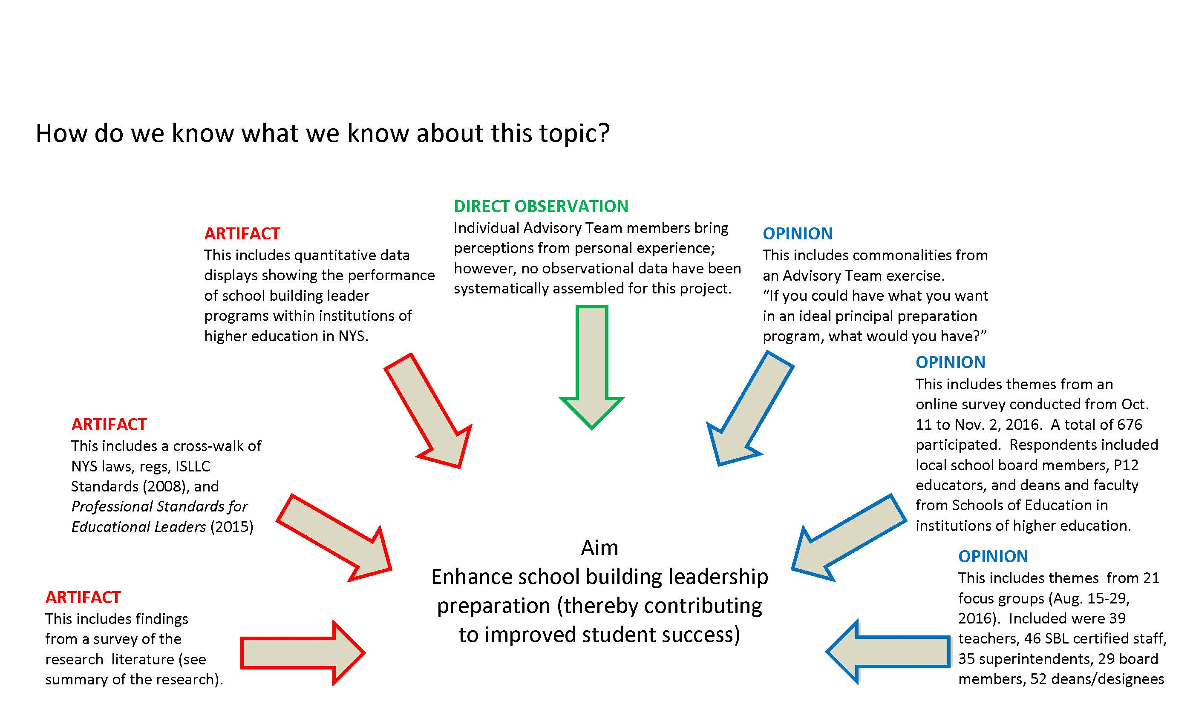
NEXT STEPS
What guided DATA COLLECTION?
Notes:
Ken Turner

Slide 25
What stakeholder opinion was gathered?
More than 50 interviews were conducted with key opinion leaders
Seven meetings were held of the 37-member Advisory Team
Six large-group meetings of stakeholder groups took place
Seven surveys were used to collect the responses of 1,684 educators and representatives of higher education institutions
21 focus groups held Aug., 2016 that involved 201 individuals
22 focus groups held Mar.-Apr., 2017 that involved 217 stakeholders
11-stop listening tour held Sept.-Dec. 2017 with 275 participants
80 documents and 5,000 pages were assembled and annotated (including but not limited to research, other state policies, and opinions from national stakeholder groups)

Slide 26

What problem are we trying to solve?
Here in NYS (as is happening elsewhere), technology, accountability, and changing demographics have created new demands on school leaders.
Practitioners have expressed concern that the preparation of school building leaders has not kept pace with the changes.
As a result, many earn SBL certification in NYS, but not enough have what is needed to be successful in the job *
* The phase “what is needed” may include ongoing guidance and support.

Slide 27


A stool with three legs: sbl Certification requirements in NYS
Requirements to earn initial SBL certification:
Have three years of experience in classroom
teaching or pupil personnel service (public or
non-public school)
Complete a NYS-registered, university-based
program for school building leaders that includes a full-time internship experience (at least 15 weeks in length).
Pass NYS SBL exam
Source: 8 CRR-NY 52.21(c)(2)

Slide 28
what SUPPORT exists to update standards (from 2008 isllc standards to 2015 psels)?
NEXT STEPS
The 37-member Advisory Team reached consensus to update the standards.
Professional organizations sent letters urging the Regents to adopt updated standards
Metropolitan Council for Educational Administration Programs or MCEAP
Collegiate Association for Development of Educational Administration or CADEA
3. Many reviewed standards/recommendations; asterisk shows those sending letters (June 2017)
Deans at Independent Colleges and University that offer SBL programs *
Empire State Supervisors and Administrators Association or ESSAA *
New York State United Teachers or NYSUT *
Ed School Deans at CUNY institutions offering SBL programs *
Professional Standards and Practices Board at NYSED *
Council for School Supervisors and Administrators or CSA *
School Administrators Association of New York State or SAANYS *
Rochester-based organizations (Urban League, Hillside Children’s Center, Mayor’s Office) *
New York State Federation of School Administrators or NYSFSA
New York State Council of School Superintendents or NYSCOSS
New York State School Board Association or NYSSBA
Ed Schools Deans at SUNY institutions offering SBL programs
United Federation of Teachers or UFT
Chancellor of NYCDOE and Superintendents of Buffalo, Rochester, Syracuse, and Yonkers
Parent-Teacher Association or NYS PTA

Slide 29
what other SUPPORT exists
for updating standards?
NEXT STEPS
In addition . . .
NYS ESSA Plan refers to Advisory Team recommendations.
In responses to an online survey, the Deans (of Ed Schools at IHEs that offer SBL program) offered their opinion on a proposed updating of the standards.
http://www.nysed.gov/common/nysed/files/graphs-of-results-of-may-2017-stakeholder-survey-on-recommendations-may-29-2017.pdf
Via online survey stakeholders expressed support for updating standards.
http http://www.nysed.gov/common/nysed/files/results-survey-deans-april-2017.pdf
Six states revised leadership standards to align with PSELs and 13 states are working to revise leadership standards to align to PSELs (according to CCSSO)
http://www.nysed.gov/common/nysed/files/principal-project-table-showing-state-progress-toward-revising-leadership-standards.pdf
NYS completed two studies to gauge if the SBL exam is aligned to PSELs.
http://www.nysed.gov/common/nysed/files/crosswalk-of-pesl-standards-and-indicators-produced-by-bank-street-professor-terry-orr-april-21-2017.pdf
http://www.nysed.gov/common/nysed/files/sbl-alignment-study-conducted-by-nysed-staff-with-assistance-of-vendor-and-practitioners-may-19-2017.pdf

Slide 30
NEXT STEPS
Dates & locations of 11-stop outreach
Albany Sept. 26 Professional Standards and Practices Board
Manhattan Oct. 10 City College faculty, NYSFSA reps, CSA rep
Manhattan Oct. 19 Metropolitan Council, Educational Admin Programs
Rochester Oct. 23 Hillside Center staff, principals, Mayor’s office rep
Bronx Oct. 25 Lehman College faculty, principals, CSA reps
Brooklyn Oct. 25 Brooklyn College faculty, principals, CSA reps
Syracuse Nov. 2 SCSD principals/supervisors and higher ed faculty
Manhattan Nov. 7 CSA reps, NYSFSA rep, and NYCDOE principals/APs
Buffalo Nov. 8 University at Buffalo faculty and school principals
Albany Nov. 13 SAANYS representatives and principals/APs
Sleepy Hollow Nov. 21 ESSAA & CAS reps and principals/supervisors
CSA is Council of School Supervisors and Administrators ESSAA is Empire State Supervisors &Administrators Association
CAS is the Council of Administrators and Supervisors SAANYS is School Administrators Association of New York State

Slide 31
TOUR PARTICIPANT COMPOSITION
Tour participant composition
Fig. 1: Participant composition (n=275)
3 HE Deans
1%
8 Community
3%
8 Teachers
3%
16 Supts or DSs 6%
115 Principals or APs 41%
26 Labor Reps
9%
27 District Admin
11%
72 Higher Ed Faculty 26%
8

Slide 32
NEXT STEPS
Themes and representative remarks
Theme #1:
PSELs make sense because of focus on equity and cultural responsiveness.
“PSELs represent a welcome improvement. In large part that is because of the emphasis on equity and cultural responsiveness. The PSELs are a step in the right direction because they put us in position to better prepare aspiring school building leaders to meet the challenges of the job.”
“The PSELs are moving in the right direction. They are moving us toward the kind of preparation that will equip [aspiring principals] to thrive in the conditions that exist in schools today. They aren’t the whole story, but they help create a better talent pipeline because they focus on the right stuff.”

Slide 33
NEXT STEPS
Themes and representative remarks
Theme #2:
Support exists for a closer relationship between universities and districts.
“Everyone benefits when there is a healthy and sustained relationship between a university-based principal preparation program and a local school, school district, or schools (and school districts and sometimes BOCES). An ongoing dialogue can be focused on planning and modifying program offerings. It can be focused on identifying future talent and it can help ensure that the internship decisions that are made are productive.”

Slide 34
NEXT STEPS
Themes and representative remarks
Theme #3:
Support exists for pilot arrangements that enable NYS to learn what works.
“Universities and school districts absolutely need to co-develop preparation programs. Pilot projects can be really helpful especially if they enable us to identify effective approaches and share promising practices with others in the field. This can help us scale up approaches that work.”

Slide 35
NEXT STEPS
Themes and representative remarks
Theme #4:
The most valuable internship is year-long and includes expectation that a candidate will lead efforts to solve a real school problem.
“We’d like to see better alignment between what is taught and expected in the university-based principal preparation program and the realities of the P12 school setting. We could see a local district identifying a specific problem of practice (or set of problems) that the aspiring principals would take on as part of preparation. Collecting these can really help the district build a collection of tools, techniques, and approaches that can assist the district and practicing administrators. It might even be a textbook that is created that includes a collection of these problems of practice.”
“We should not under-state the value of an extended period (year-long, if possible), job-embedded, internship (that is ideally paid).

Slide 36
NEXT STEPS
Themes and representative remarks
Theme #5:
Principals (both novice and experienced) benefit from high-quality coaching and mentoring coupled with initial and ongoing professional development.
“A vitally-important piece is the provision of coaching, not just for new principals but for all principals.”
“Skilled coaches (on site, not virtual) can be the lifeline that a principal needs so (s)he can work in a safe environment on areas of need.”
“Coaching and mentoring are vital here. In their university training, candidates may or may not have read a book [about a particular topic] but through coaching and mentoring they can learn what is needed here.”

Slide 37
NEXT STEPS
Themes and representative remarks
Theme #6:
Dec. 2020 is a realistic date for university-based principal preparation programs to register their programs consistent with the PSELs. Dec. 2022 is realistic deadline for principal evaluation that is organized around PSELs.
“The date of 2020 is a realistic timeline for universities to adjust their principal preparation programs so they are organized around the 2015 Professional Standards for Educational Leaders.”
“The deadline of 2022 is OK for the evaluation of principals using a rubric that is based on the Professional Standards for Educational Leaders.”

Slide 38
NEXT STEPS
Themes and representative remarks
Theme #7:
Alignment matters.
“There is a lot to like about the PSELs. They’re aligned to important things. As an administrator in a school and a district that experienced the Comprehensive Diagnostic Need Assessment that NYSED conducts (where a tool is used called the Diagnostic Tool for School and District Effectiveness or DTSDE), I think there should be alignment between the PSELs and these processes. As well, I think there should be alignment between PSELs and Annual Professional Performance Review (APPR).”

Slide 39
NEXT STEPS
Themes and representative remarks
Theme #8:
Attention should be paid to growth.
“My question in all of this is this. What master do these new standards serve? If it is accountability, then they are just going to be perceived as leverage for discipline. I would hope instead that they exist to support the growth and development of educators. Successful implementation depends on being as clear about that as we can be.”
“Let’s remember that the standards are the goals. We are trying to implement them so students flourish. There isn’t enough of a ‘growth mindset’ around here.”

Slide 40
NEXT STEPS
Themes and representative remarks
Theme #9:
It is important to translate PSELs into competencies to focus professional development and principal evaluation.
“A lot of work will be needed to translate these standards into measurable competencies. That is especially true for something that is new like cultural responsiveness.”
“With cultural diversity such a reality for us, we need to infuse preparation with as many points of view as possible. What does a set of competencies look like not just for principals but for their supervisors.”

Slide 41
NEXT STEPS
Themes and representative remarks
Theme #10:
PSELs are ambitious; if adopted, they should be translated into expectations (rubrics) appropriate for new versus experienced principals.
“It seems like we need to have a consistent set of standards, but we need a graduated set of expectations. The novice principal is not evaluated in precisely the same way or with the same expectation of performance as the apprentice or the master principal. Local standards and state standards need to match up.”

Slide 42
NEXT STEPS
Themes and representative remarks
Theme #11:
When it comes to P20 partnerships, we need standards without standardization.
“I think we need standards but not standardization. If we standardize around one approach a handful of people will fall through the cracks. The exact form of the partnership will reflect the kind of community that is being served. What we need is standards but enough flexibility in the system that we’re responsive to community needs.”

Slide 43
NEXT STEPS
Themes and representative remarks
Theme #12:
As we plan for implementation, it is important to be mindful of the impact of these changes on equity.
“I want to return to our conversation about standards and standardization. I just ask us all to think about and commit to making sure that we keep a clear focus on one thing. That is equity. Through the transition, will or how will these standards and/or standardization impact equity? It is easy to say that implementation matters. What really matters today is that equity is advanced.”

Slide 44
NEXT STEPS
Themes and representative remarks
Theme #13:
If PSELs are adopted, it is important to adjust expectations of principal supervisors (so principals receive needed guidance and support).
“For me, alignment is the main idea. We need to know that the superintendent has a good understanding of the PSELs. I want to be sure that the way I as a principal am evaluated is well understood by the superintendent and by my supervisor.”

Slide 45
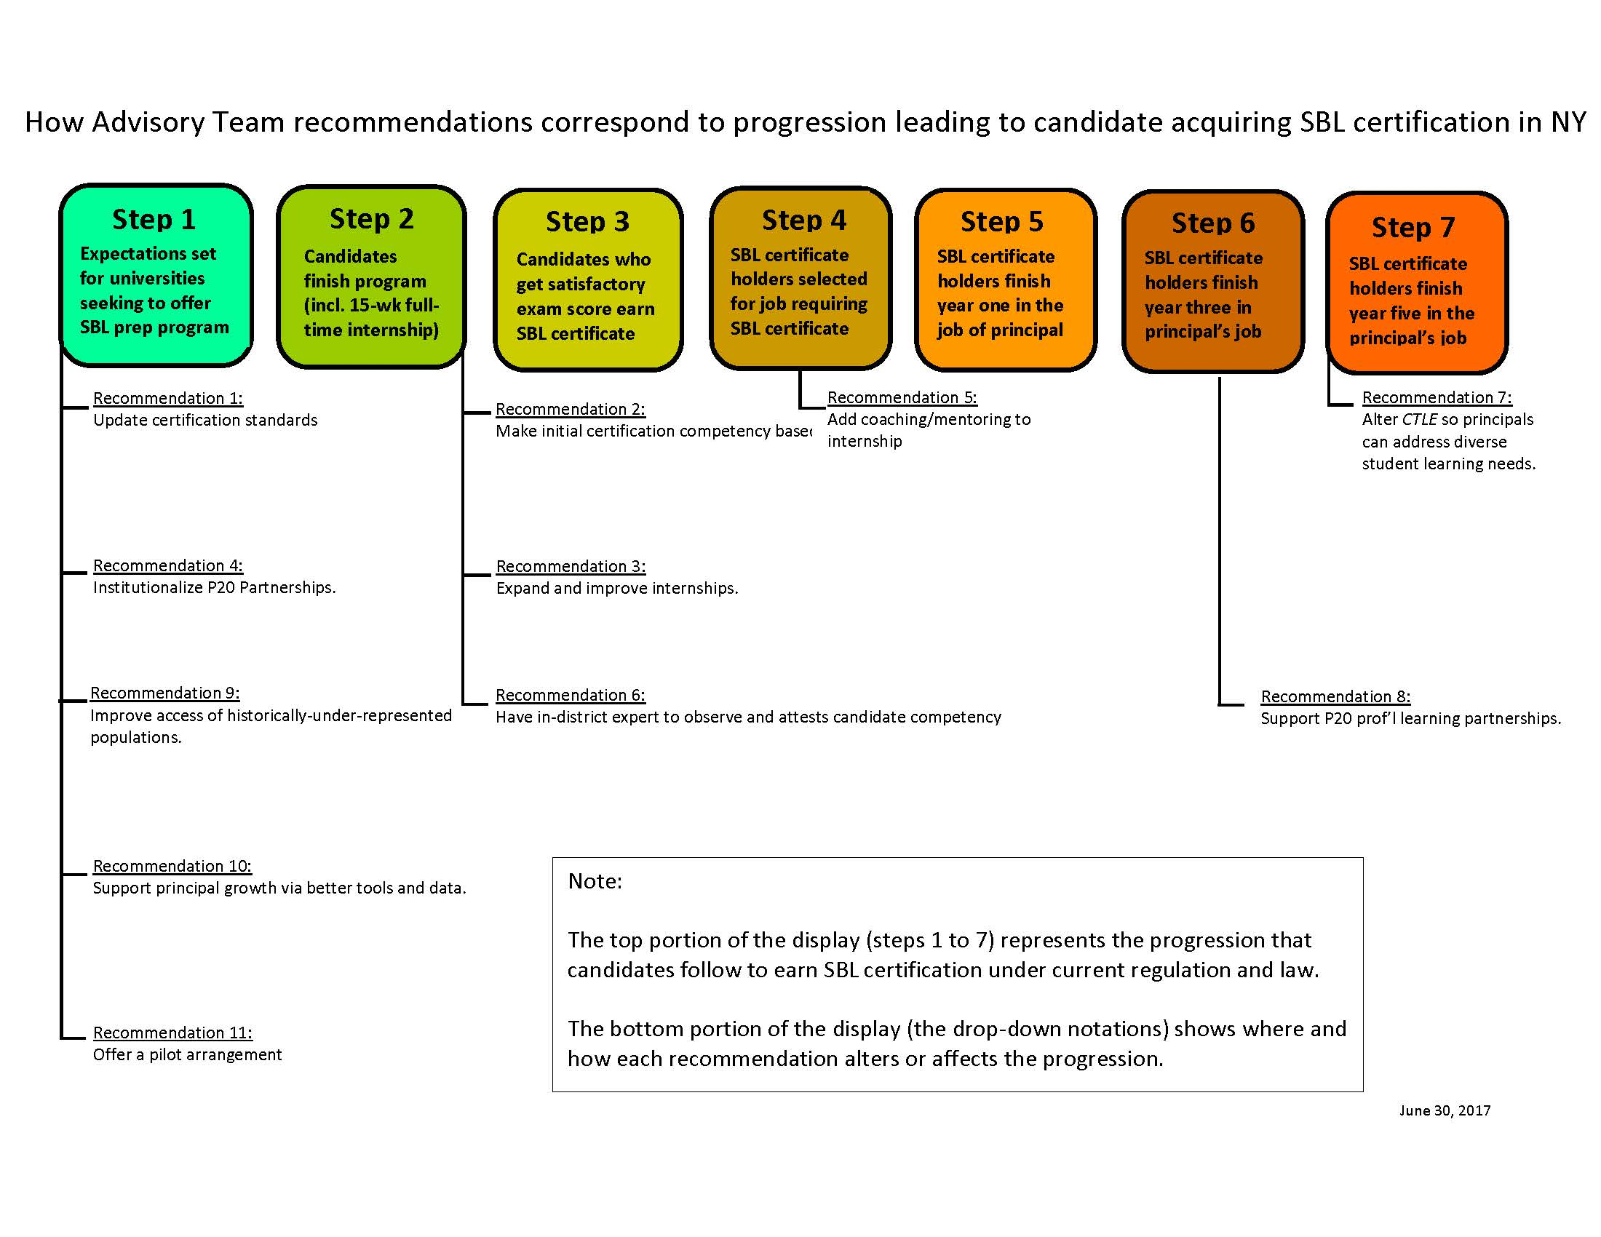
NEXT STEPS
how do these recommendations correspond to the sbl progression that is now in place in nys?

Slide 46
NEXT STEPS
Where do we go next?
Phase 2 . . .
Establish a P20 partnership framework that builds on Advisory Team recommendations but better defines the relationship between university-based prep programs and districts that host internships for aspiring leaders.
Adopt standards guiding SBL Prep Programs using PSELs and forthcoming National Educational Leadership Preparation Standards for guidance.
Propose a way to issue micro-credentials to address learning needs of existing principals or in partial fulfillment of SBL requirements for candidates
Recommend changes needed to the standards for principal supervisors (and Superintendents) so they are aligned with the PSELs.
Recommend whether competency-based assessment should augment or replace the current School Building Leader examination.
Notes:
Erika Hunt

Slide 47
NEXT STEPS
Timeline for work of a 52-member Phase 2 Advisory Team:
January 17 and 31 Meetings of the Phase 2 Team
February 28 Meeting of the Phase 2 Team
March 21 Meeting of the Phase 2 Team
April through May Focus groups and statewide survey
June Re-convene Phase 2 Team via webinar (last check-in)
June Submit recommendations to Commissioner & Regents

Slide 48
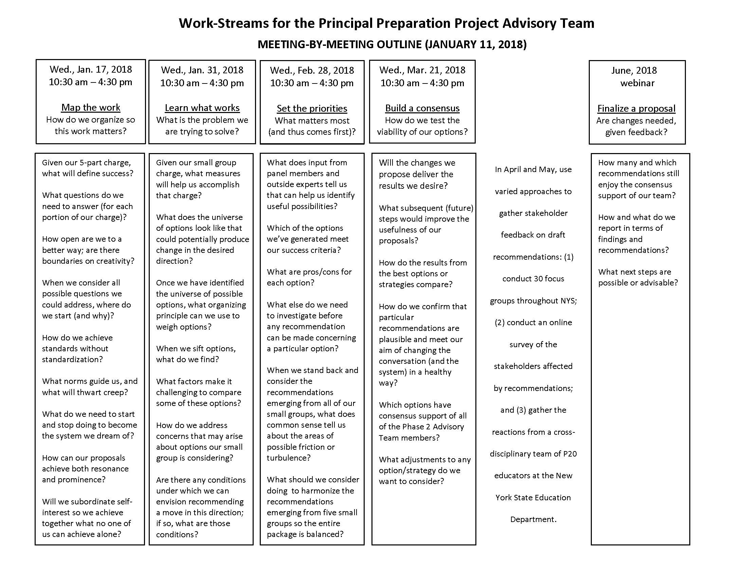
Where do we go next?

Slide 49
sed effort (apart from phase 2 charge)
PRINCIPAL PREP SEQUENCE: FUTURE STEPS
Determine how university-based preparation programs will re-register.
Following PSELs adoption, develop competencies aligned to PSELs.
Convert competencies into a rubric to guide professional development
Convert competencies into a rubric to guide principal evaluation
Use ESSA funding for P-20 partnerships aimed at principal preparation
Encourage school districts to use School Improvement Grant funds (under ESSA) for mentoring, coaching and principal professional development

Slide 50
Cadea assistance to sed
PRINCIPAL PREP SEQUENCE: FUTURE STEPS
On January 12, 2018 CADEA convened in Albany to consider a way forward for program re-registration. Several recommendations emerged. These include a starting set of evidence that SED could consider when reviewing program redesign proposals from universities. Patterned after elements defined by the NYS TLQP guidelines, CADEA members added specific suggestions for SED to consider.
Importantly, going forward, SED leadership has indicated the desire to collaborate with CADEA members in further defining and detailing the process and timing that will be used to guide program re-registration (with special attention to evidence requirements).
Finally, CADEA weighed in on the topic of recommendations concerning modifications to regulations to guide principal preparation programs (that are now being considered by the Phase 2 Advisory Team). CADEA urged SED to refrain from issuing definitive guidance until NELP standards are released in final form.

Slide 51
REFERENCES
Related Regents Items
http://www.regents.nysed.gov/common/regents/files/517hed2.pdf
http://www.regents.nysed.gov/common/regents/files/HE%20-%20Principal%20Preparation%20Project%20Update.pdf
http://www.regents.nysed.gov/common/regents/files/916brd1revised.pdf
http://www.regents.nysed.gov/common/regents/files/Principal%20Preparation%20Project%20-%20Full%20Board%20Monday.pdf
http://www.regents.nysed.gov/common/regents/files/1216bra7.pdf
All material for the Principal Preparation Project Advisory Team can be found at:
http://www.nysed.gov/principal-project-advisory-team

