Slide 1

PRESENTATION ON A WALLACE FOUNDATION FUNDED PROJECT
Principal Preparation Project
to the
Staff/Curriculum Development Network
Ken Turner
Director, Principal Preparation Project
University of the State of New York – Regents Research Fund
February 8, 2017
1

Slide 2
People are poor because they make bad decisions.
People make bad decisions because they are poor.
WHICH IS MORE LIKELY TRUE?

Slide 3
THE PSYCHOLOGY OF SCARCITY
A puzzle and a story

Slide 4
What happens when plane landings go awry . . .
And what it means for our work

Slide 5
In WWII, the U.S. was plagued with unexplained bomber crashes.
Often missions ended tragically and at the last possible moment.
These involved landings on friendly home airfields located abroad.
Inexplicably, pilots retracted the landing gear on touch-down.

Slide 6
The question is, why?
Was it carelessness?
. . . training?
. . . stress?
. . . fatigue?
. . . distractions?

Slide 7


Slide 8


Slide 9


Slide 10


Slide 11
After exploring possibilities, it dawned on officials.
While stress and lack of sleep can alter cognitive function,
. . . the accident source was traced to cockpit design.
Once the source was understood, the solution was easy.
Small design tweaks reduced error that had led to tragedy

Slide 12
The message for us?

Slide 13
Possibly the message is this . . .
To improve things we have tools at our disposal
But be cautious when deciding which tool to use
A hammer can help build a cathedral or tear it down
Focus on the wrong thing can hinder more than help

Slide 14
Or maybe the message is this . . .
Avoid obvious solutions that focus on the wrong thing
Especially if solutions blame those we’re trying to help
Remember, people don’t fail; systems do

Slide 15
Or maybe the message is this . . .
The “choice architecture” matters.
How choices are presented affects decision-making.
The goal is simple.
Change choices without reducing freedom to choose.
Make small changes that yield big improvement.

Slide 16
Source:
S. Mullainathan and E. Shafir, Scarcity: The New Science of Having Less and How it Defines our Lives, 2013, p. 167-169
Sendhil Mullainathan
MacArthur Fellowship recipient
Professor of Behavioral Economics

Slide 17
PROJECT AIM
Enhance school building leadership preparation (thus contributing to improved student success)

Slide 18

ANTICIPATED OUTCOMES
PROJECT OUTCOMES
Engage stakeholders in efforts to:
Review requirements related to preparation of school building leaders
Identify if and where improvements are needed (related to certification and program requirements, professional development, supervision, and/or evaluation)
If warranted, forward recommendations to Commissioner & Regents
Develop a tool to help districts identify, select, & place school building leaders

Slide 19

RATIONALE
Belief
Students thrive in the presence of great teachers and principals
Aim
Promote data, tools, and policy changes that will enhance the quality of school building leader preparation in New York State
Mission
Make recommendations to the NYS Board of Regents that are designed to enhance the preparation of school building leaders and enhance the prospects of success for students on their watch

Slide 20

STAKEHOLDERS
STAKEHOLDERS
Teachers
School building leaders
Superintendents and District Superintendents
School board members
•
•
Deans and faculty at colleges of education
Parents
Civil rights organizations

Slide 21

RATIONALE (CONTINUED)
WHAT PROBLEM ARE WE TRYING TO SOLVE?
WHAT PROBLEM ARE WE TRYING TO SOLVE?
Technology, accountability, and changing demographics have created new demands on school leaders
Practitioners express concern that preparation of our school building leaders has not kept pace with these changes
Many earn SBL certification in NYS, but too few who earn
certification are ready to step into the position.

Slide 22
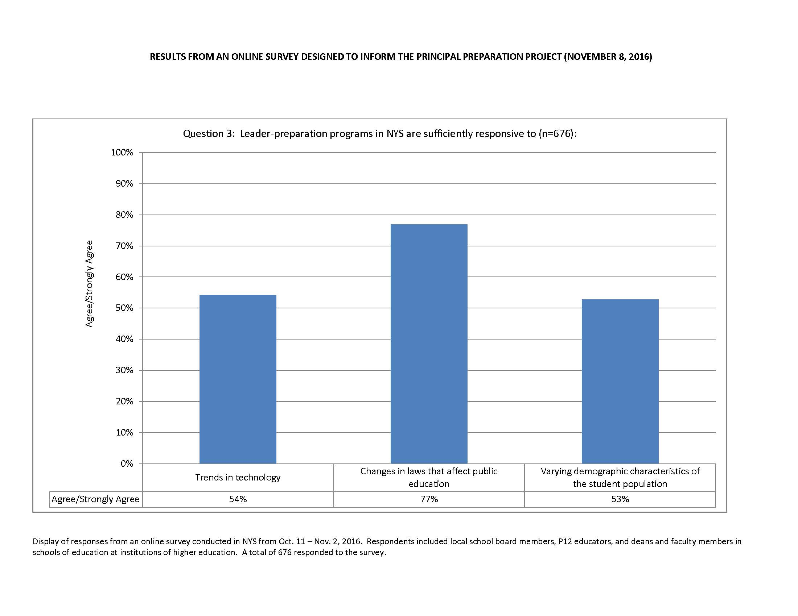

Slide 23

RATIONALE (CONTINUED)
HOW URGENT IS THE CHALLENGE?
HOW URGENT IS THE CHALLENGE?
Districts typically expend 80% (or more) of operating funds on people
One of the most important decisions they face involves how they recruit, select, develop and retain effective school building leaders
Yet NYS has not recently revised the requirements for the programs used to prepare school building leaders.
Notably, in 2015 the National Policy Board for Educational Administration developed and the Council of Chief State School Officers copyrighted the “Professional Standards for Educational Leaders”

Slide 24
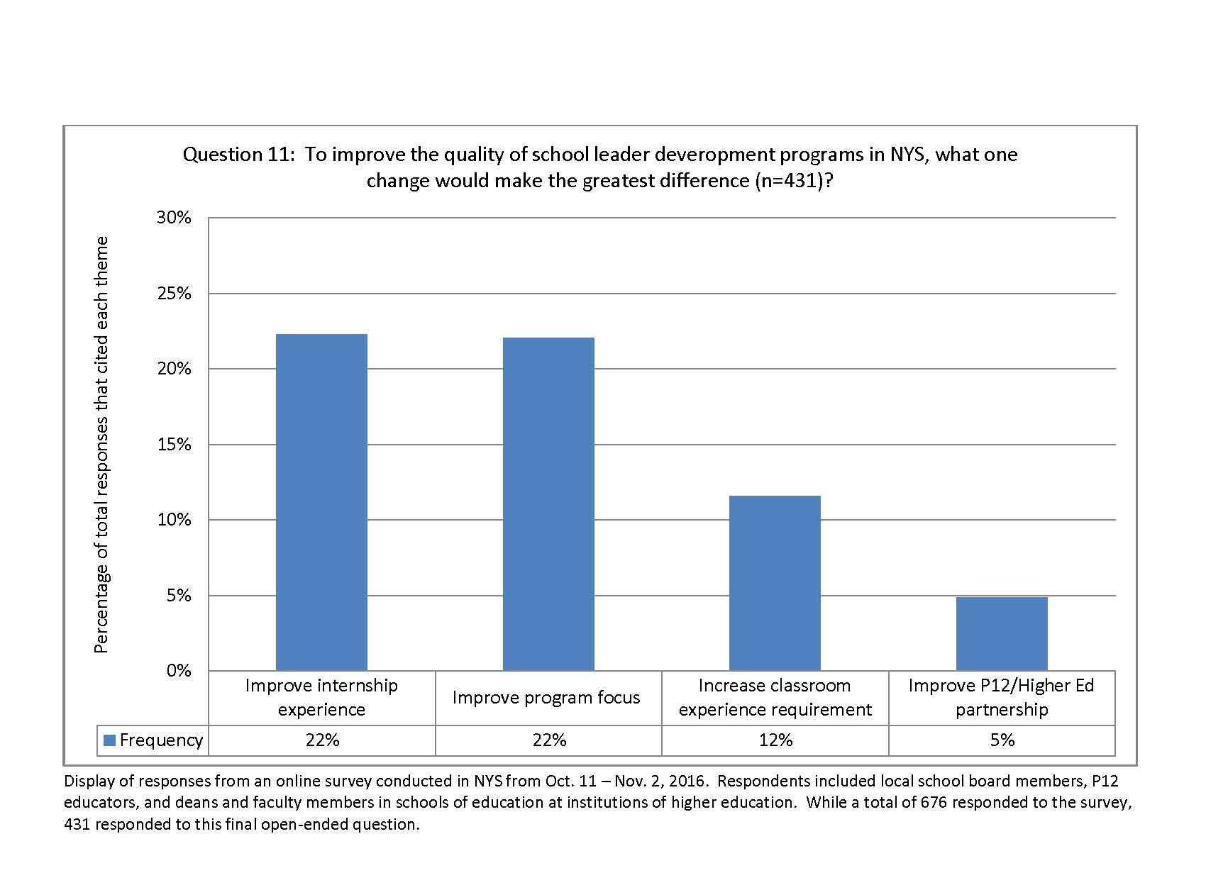

Slide 25

IS THERE MORE TO THIS?
RATIONALE (CONTINUED)
IS THERE MORE TO THIS?
Educators who have an interest in the preparation of school building leaders (P-12 and higher education) routinely commit to continuous improvement
However, continuous improvement efforts are impeded because data to measure the effectiveness of leader preparation and the outcomes of students over time are sparse and of questionable quality
At issue is the accessibility of data as well as its comparability across individuals, institutions, and time periods. This makes it a challenge to accurately gauge program effectiveness and hiring decisions

Slide 26
BACKGROUND ON INDIVIDUAL REQUIREMENTS RELATED
BACKGROUND ON INDIVIDUAL REQUIREMENTS RELATED
TO CERTIFICATION TO BECOME A SCHOOL BUILDING LEADER
TO CERTIFICATION TO BECOME A SCHOOL BUILDING LEADER
Once admitted, requirements for individuals to earn initial School Building Leader certification:
Three years of experience in classroom teaching or pupil personnel service (public or non-public school)
Satisfactory completion of a NYS-registered, university-based graduate program for school building leaders that includes a
full-time internship experience of at least 15 weeks in length
Pass necessary exams (SBL exam & Educating All Students exam)
Sources: 8 CRR-NY 52.21(c)(2)

Slide 27
What has Transpired Since Last Update
to Regents on September 12th, 2016
Progress Since LAUNCH May 1, 2016
Assembled a Project Advisory Team and convened four meetings thus far
Completed 21 focus groups throughout NYS (second round scheduled for Mar.)
Completed review of the research literature (85 documents/5,000 pages)
Reached consensus on six belief statements as a foundation for this work
Completed online survey of 676 respondents, incl. local board members, P12 educators, & education school faculty in higher education institutions
Buffalo and Syracuse School Districts will be leader pathway tool test-beds
Polled Regents on the Professional Standards for Educational Leaders
Organized Advisory Team to address five priority areas, including:
Partnership between P12 and Higher Education
Authentic Experiences and the Internship
Standards for Certification and Programs
Diversity
Professional Learning and Support
4

Slide 28
Recap: Deliverables
Starting point: Vision
To develop a sense of possibility, Advisory Team members addressed a single question at the outset:
If we could have what we want in an ideal program to prepare school building leaders, what would we have?
3

Slide 29
Themes Captured in Belief Statements
Recap: Deliverables
Themes emerged from the responses provided by Team members.
3

Slide 30
Belief Statements (ADVISORY TEAM APPROVED)
Survey of the Field
Consensus was reached on the following six beliefs:
Purpose
Well prepared school building leader candidates make it their mission to support staff in the school so every student is equipped for success in the next level of schooling, career, and life; further, candidates have the ability to translate goals into plans, action, and desired results.
Instruction
Well prepared school building leader candidates have the knowledge and skill to improve teacher instruction and student learning.
5

Slide 31
Belief Statements (ADVISORY TEAM APPROVED)
Survey of the Field
Consensus was reached on the following six beliefs:
Shared Decision-Making and Shared-Leadership
Well prepared school building leader candidates have the willingness and ability to share decision-making and distribute leadership.
Continuous Improvement and Change Management
Well prepared school building leader candidates display the emotional intelligence, skill, and grace needed to manage the tension and conflict that can arise when schools engage in continuous improvement efforts.
5

Slide 32
Belief Statements (ADVISORY TEAM APPROVED)
Survey of the Field
Beliefs supported by consensus include:
Equity
Well prepared school building leader candidates cultivate a climate of compassion and care for the well-being of every child in the school; candidates create a culture that strives to support the learning needs of every student in an environment where all students are valued, are respected, and experience success regardless of their differences (age, gender, socio-economic status, religion, race, ethnicity, sexual orientation, disability, native language, or national origin
Value Diversity
Effective school building leader preparation programs recruit and produce aspiring leaders from varied backgrounds and historically-under-represented populations who are committed to the success of every student, who value different learning styles, who promote instructional practices that capitalize on a range of cultural traditions, and who strive to eliminate prejudice, stereotype, bias, and favoritism.
5

Slide 33
Belief Statements (under development)
Survey of the Field
Collaborative Partnership
Well-prepared building leader candidates have the skill, ability, and desire to collaborate so students, staff, and parents feel they belong and community members are valued and appreciated as respected partners
Innovation
Well-prepared school building leader candidates embrace innovation.
Reflective Practice
Well-prepared building leader candidates rely on collegial feedback, student evidence, and current research to guide practice and inform decisions.
5

Slide 34
Belief Statements (under development)
Survey of the Field
Shared Responsibility for Feedback
Effective school building leader preparation programs work with districts to pair each aspiring principal with a trained mentor who is a successful administrator who provides mentoring advice to the leader candidate (on how to improve) and feedback to university faculty (on how to refine the preparation program.
Skillful Practice under Authentic Conditions
Effective school building leader preparation programs produce aspiring principals who demonstrate their readiness for school leadership by successfully applying the skills and knowledge they acquired in the university setting during the course of an internship.
Program Admissions
Effective school building leader preparation programs enhance the quality of aspiring building leaders by raising the expectations used to admit candidates and through the use of a richer array of evidence that provides a better picture of candidate fitness for the position and readiness for admission.
5

Slide 35
Recap: Deliverables
Focus Shifts to Current State of Affairs
To capture the current state, data were collected:
Opinion Data
Artifact Data
Note: Observation data have not been part of the work
3

Slide 36
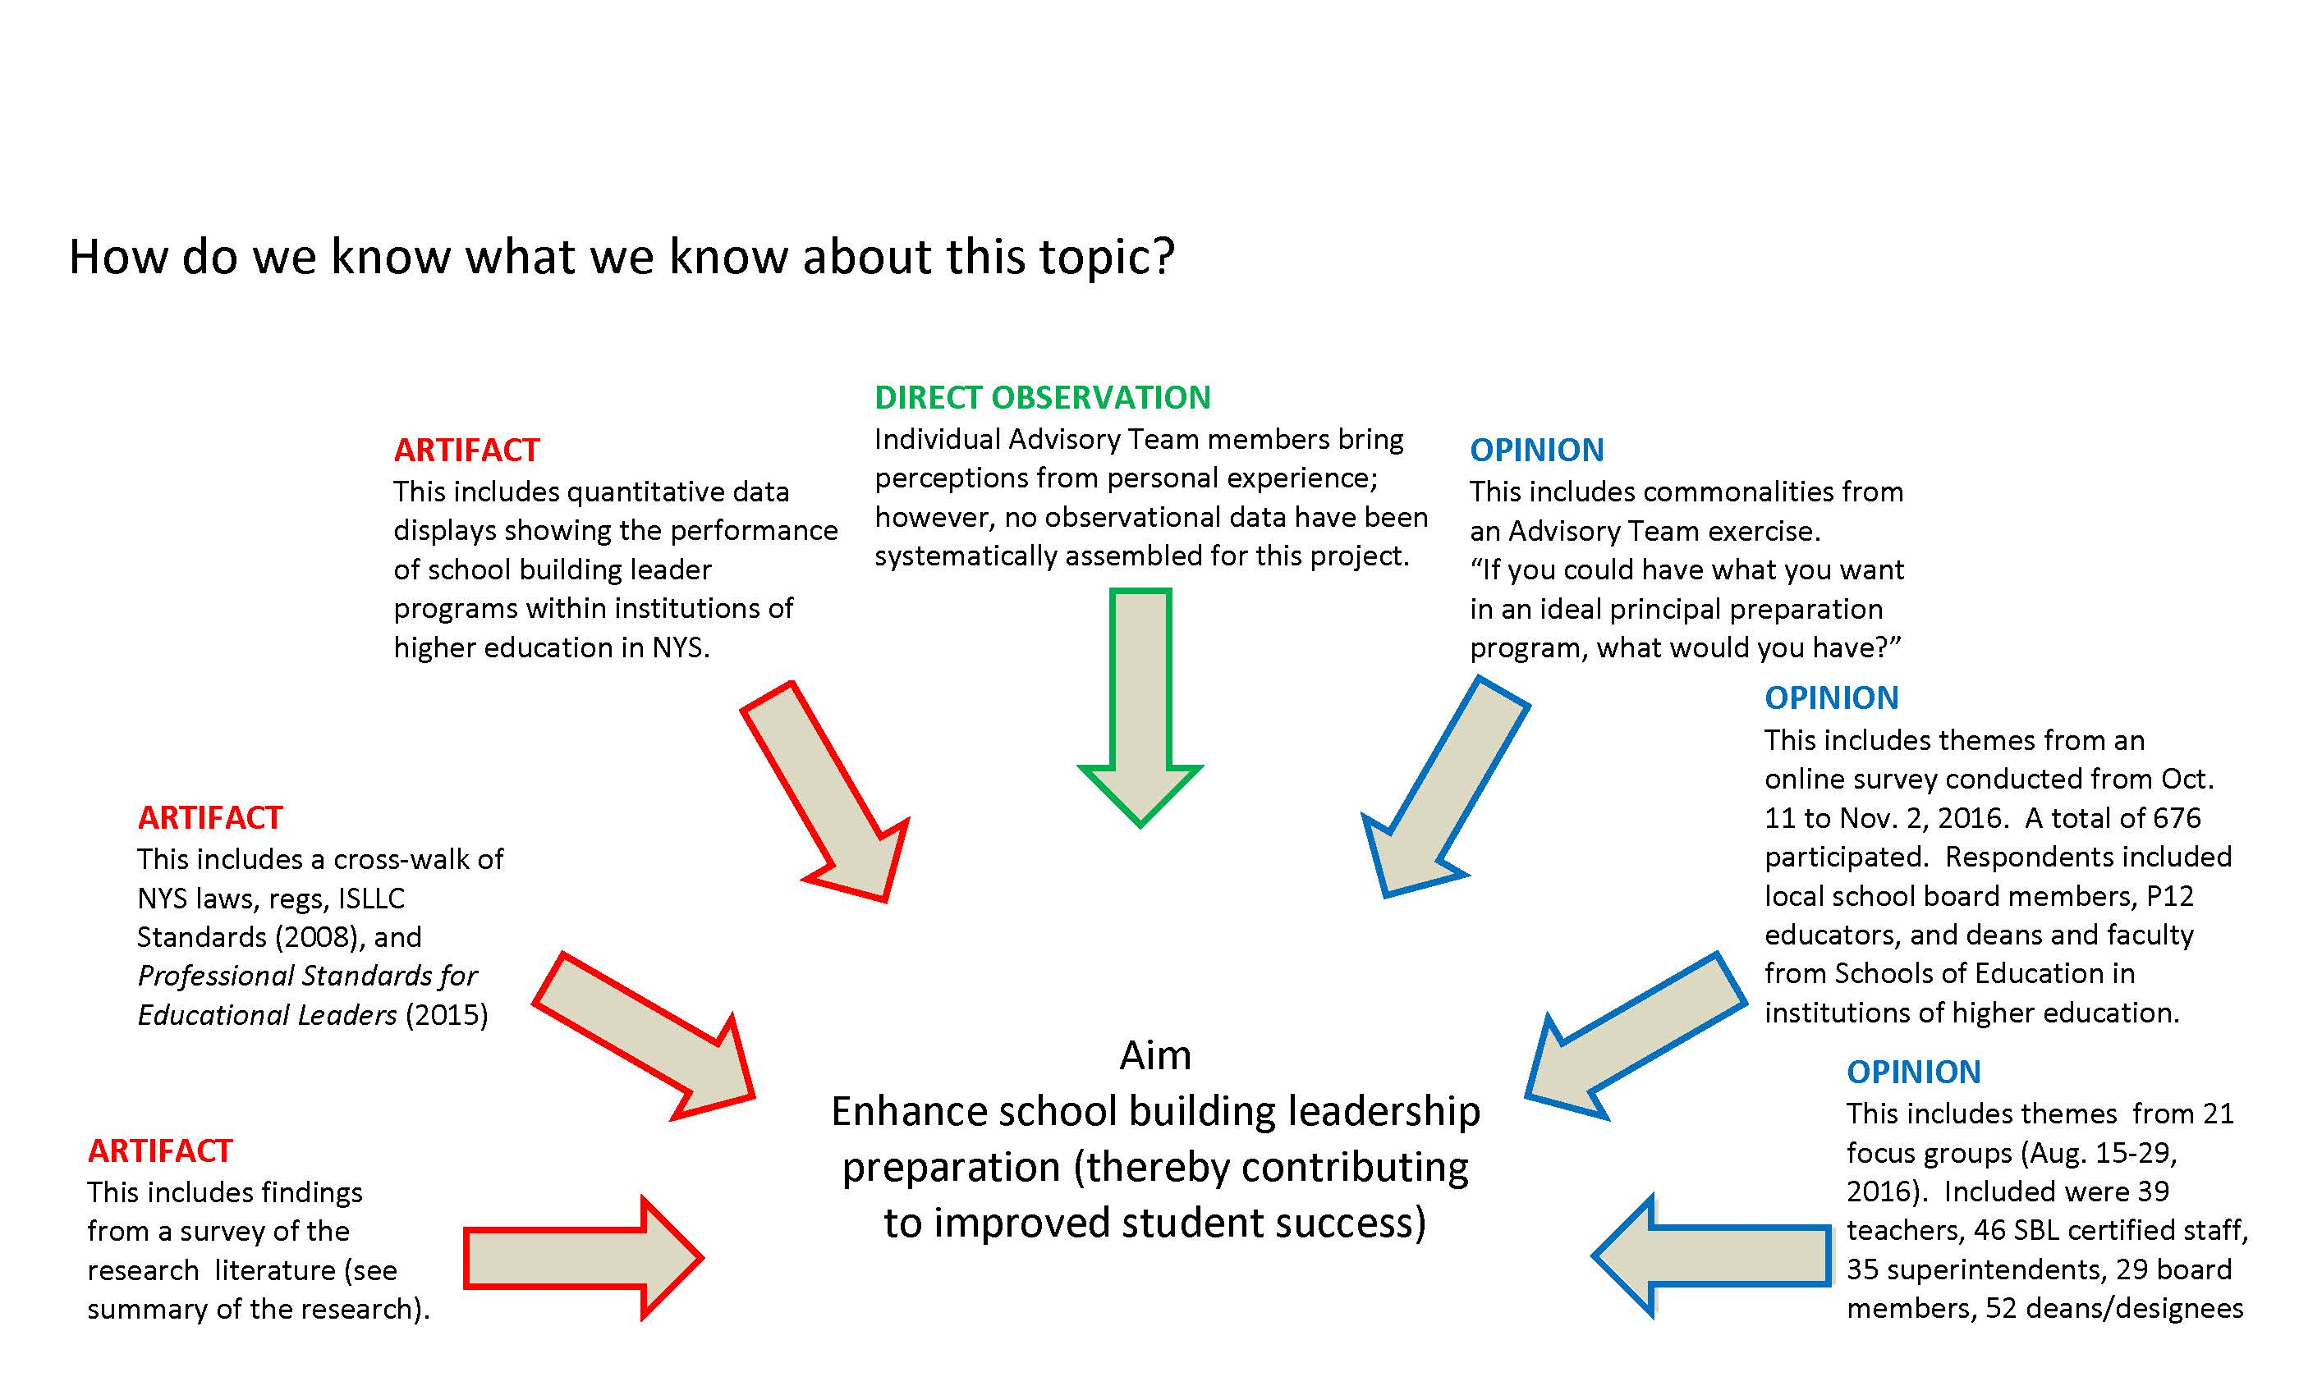
Sources of data (by type of data)
3

Slide 37
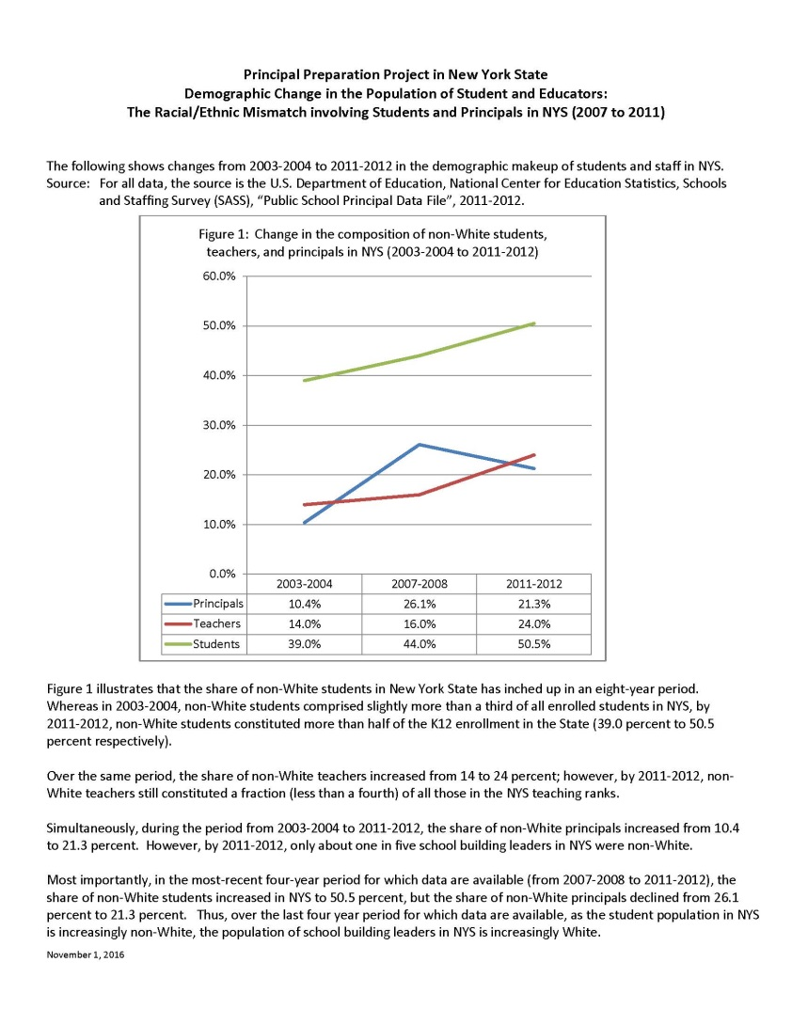
This displays data over the period from 2003-2004 to 2011-2012.
This shows that the share of non-White students in NYS has inched up in an 8-year period (reaching 50.5% by 2011-2012).
Yet simultaneously, in the most-recent 4-year period (2007-2008 to 2011-2012), the share of non-White principals in NYS declined from 26.1 percent to 21.3 percent.

Slide 38
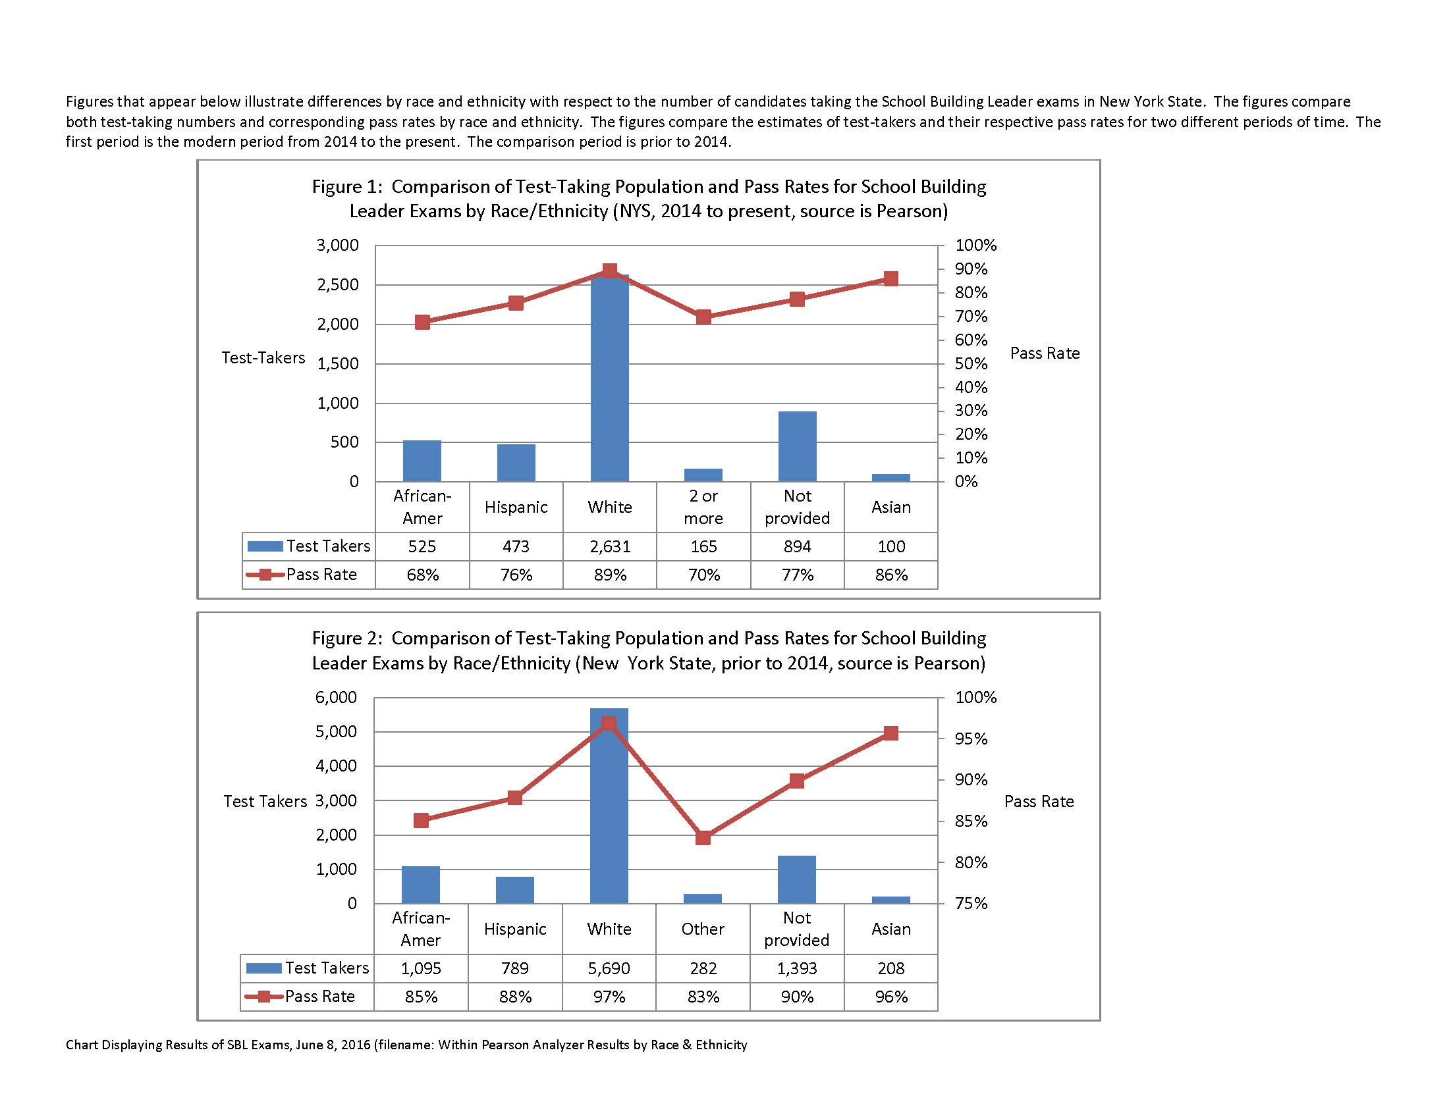

Slide 39
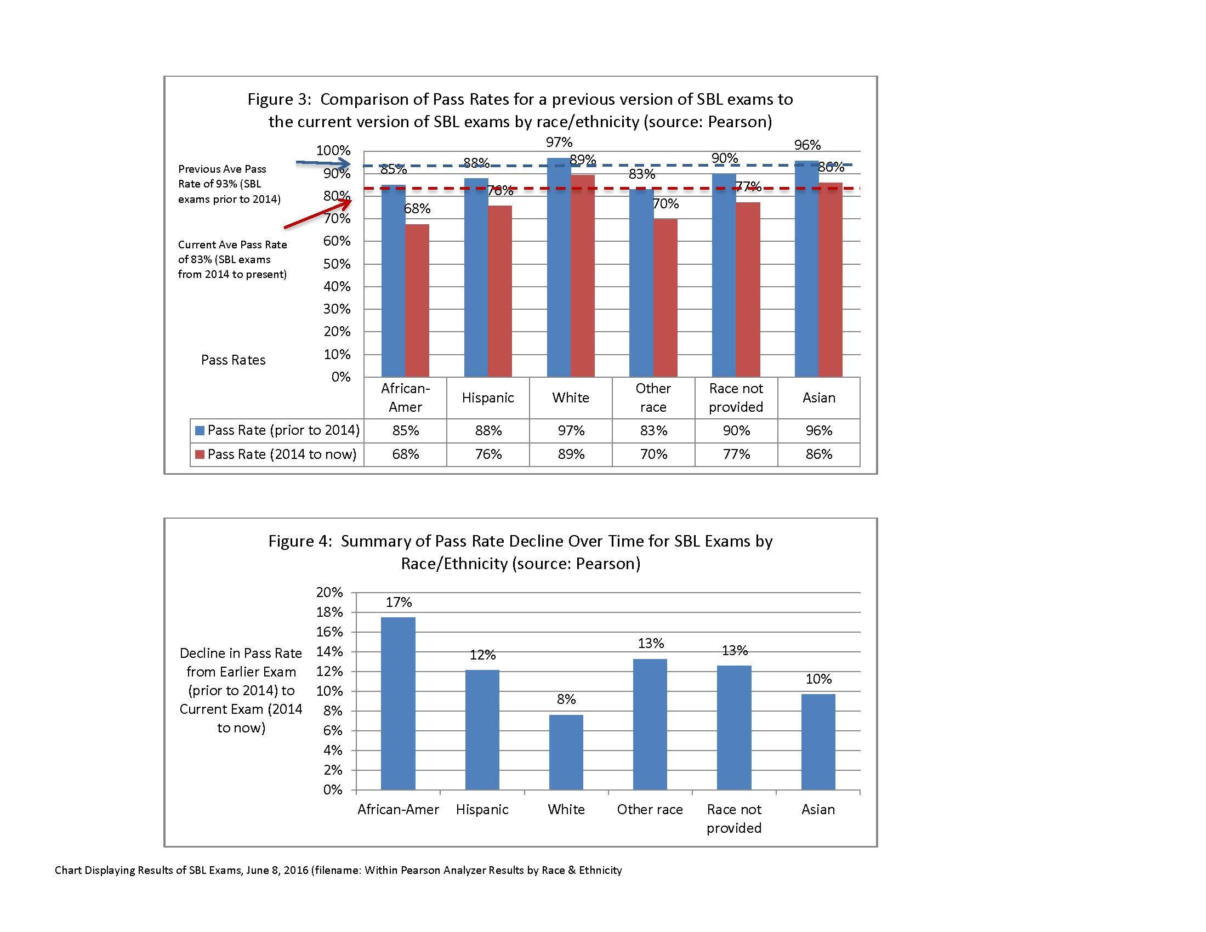

Slide 40
Survey of THE Field (Results)
Survey of the Field
5

Slide 41
Survey of THE Field (Results)
Survey of the Field
Defining terms used in the summary found in the previous slide:
Term: Improve internship experience
“High-quality internship experiences [are needed].”
“Full-year or two half-year internships [are needed].”
“A quality internship is the key to success. It is essential for it to be done in collaboration with most skilled principals.”
Term: Improve program focus
“Ensure programs are connected with the realities of the Principal-ship.”
“[What is needed is] standards-driven, research-based practice [and] application of skills with University feedback.”
“[Future leaders need] to learn to balance management of minute-to-minute issues with executing the bigger vision.”
Term: Increase classroom experience requirement
“[Aspiring principals] need at least 6 years of classroom experience.”
“Must have more years in the classroom than now required.”
“Require candidates to teach for at least 5-7 years [and] requiring a broader background.”
Term: Improve P12/Higher Ed Partnership
“Partner with a local public school district for supervised internships, mentoring, and PD [professional development].”
“Strong partnership [is needed] with a district to provide candidates with quality internship.”
“Higher ed and districts should engage more in dialogue about appropriate internship tasks.”
5

Slide 42
What has Transpired Since Last Update
to Regents on September 12th, 2016
With beliefs in hand and data reviewed, attention turned to 5 areas
P12-Higher Education Partnership
Enhance the productivity and healthy inter-dependency of the P12-Higher Education relationship
Authentic Experiences and Internship
Expand and improve the opportunities (not just within an internship) for principal candidates to apply the knowledge/skill they have acquired under real conditions
Standards
Replace 2008 standards with some form of 2015 Professional Standards for Educational Leaders; consider 2015 national standards for principal supervisors
Diversity
Produce school building leaders from varied backgrounds (including historically under-represented populations) and prepare all school building leaders with the skills/knowledge to meet varied learning needs of a diverse student population.
Professional Learning and Support
Improve support beyond appointment as principal to foster situational awareness, system thinking, shared leadership, stakeholder engagement.
4

Slide 43
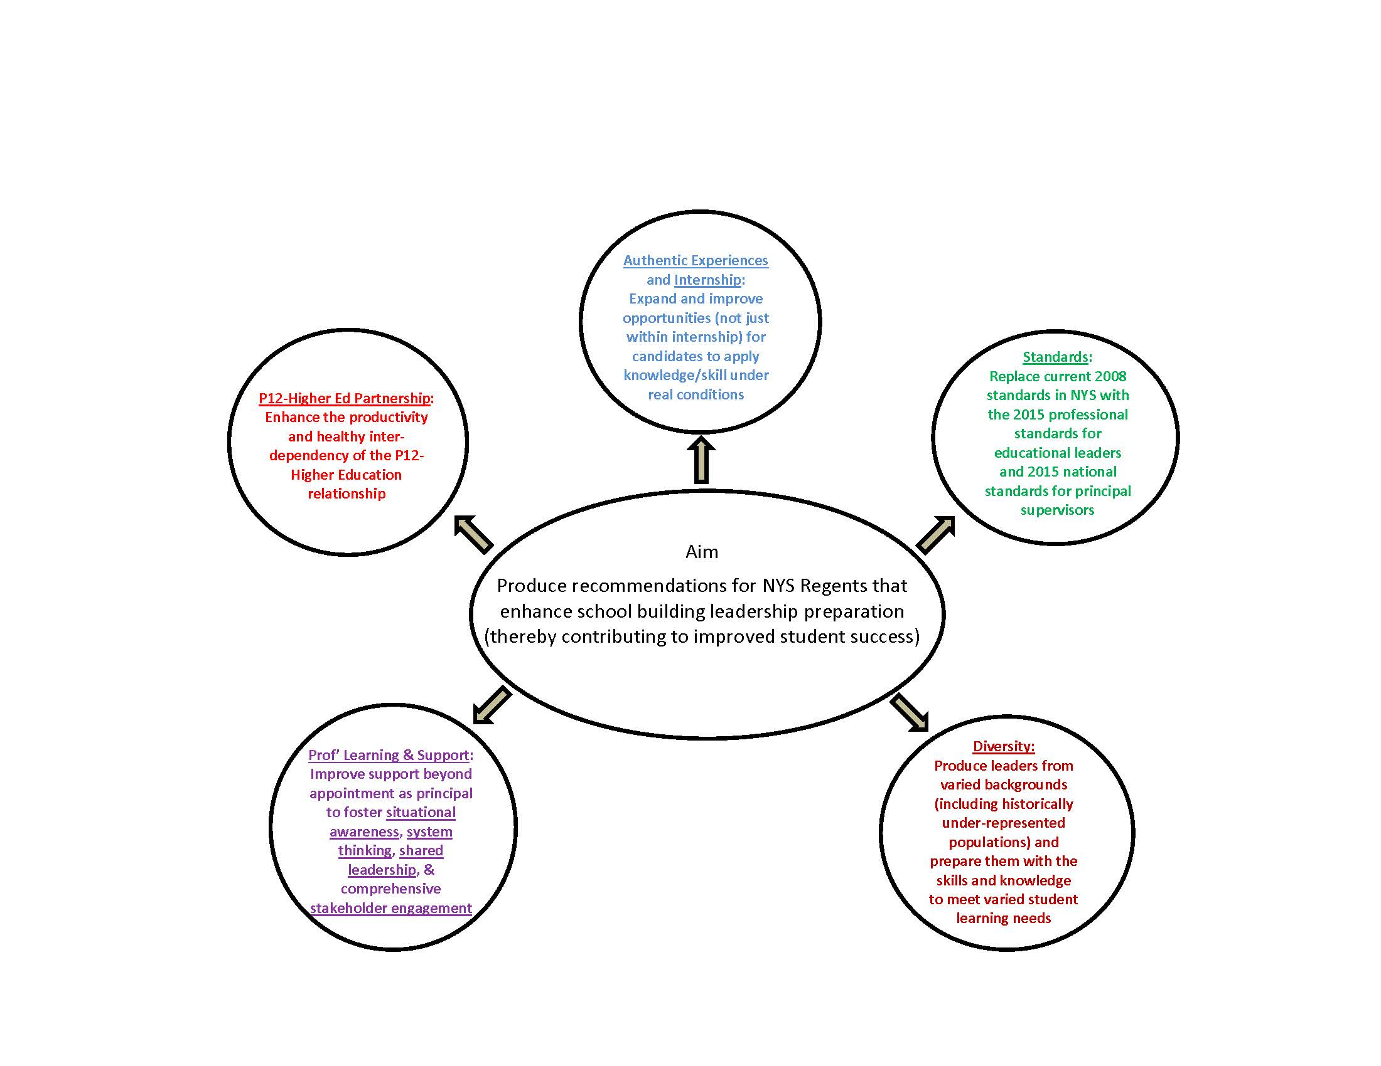

Slide 44
Grant Funding extension Approved by NYS Regents in December 2016
NEXT STEPS
On Dec. 13, 2016 the Board of Regents approved a $500,000 grant from Wallace Fdn to extend this work
Better define the relationship between university-based prep programs and districts that host internships for aspiring principals.
Study whether to apply Title II Part A funds for this purpose
Create a case study of the State approach to ESSA planning
Study merit of making certification competency-based
Formalize an expectation that aspiring principals will apply what they know in authentic settings prior to certification
12

Slide 45
HIGH CONCEPT PAPER
(UNDER CONSIDERATION BY ESSA THINK TANK)
See attached

Slide 46
Events Leading to NYS Regents Consideration of Recommendations
March 22, 2017
- Reach consensus within the Advisory Team on preliminary recommendations
March 31, 2017
- Complete second round of 20 focus groups and complete survey of the field
May 1, 2017
- Reach Team consensus on revisions that take account of feedback from the field
May 8-9, 2017
Provide the Commissioner and NYS Board of Regents with recommendations
May 31, 2017
Reach Advisory Team consensus on final adjustments that may be needed.
June, 2017
- NYS Board of Regents considers recommendations for action
11

